Slide 1
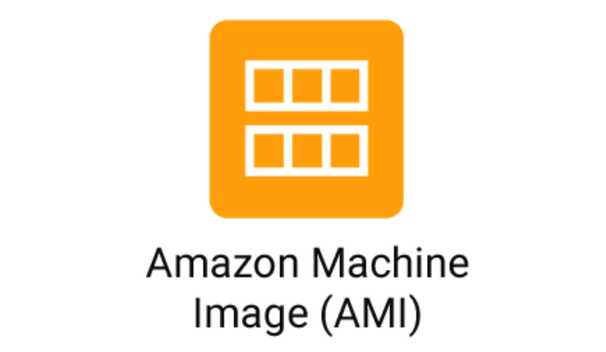

Slide 2

Topics
What is AMI?
Type of AMI
Exam Tip

Slide 3
What is a hypervisor?
A hypervisor, also known as a virtual machine monitor or VMM, is software that creates and runs virtual machines (VMs). A hypervisor allows one host computer to support multiple guest VMs by virtually sharing its resources, such as memory and processing.
Hypervisors make it possible to use more of a system’s available resources and provide greater IT mobility since the guest VMs are independent of the host hardware
Hypervisors make it possible to use more of a system’s available resources and provide greater IT mobility since the guest VMs are independent of the host hardware

Slide 4
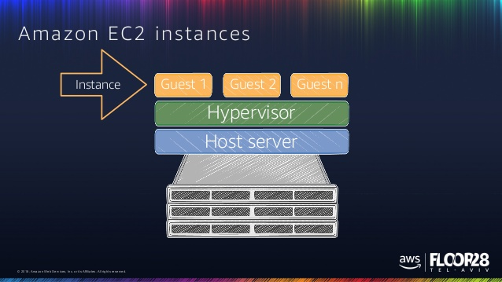
What is a hypervisor?

Slide 5
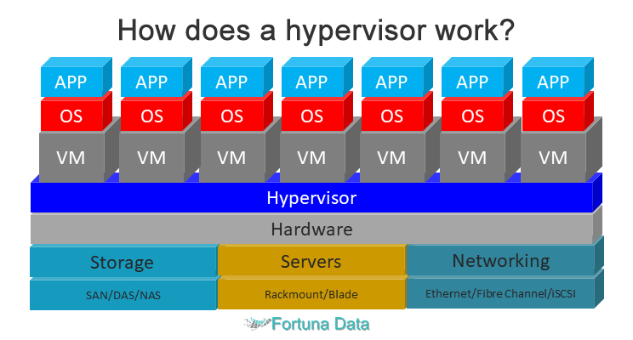
What is a hypervisor?

Slide 6
What is AMI?
An Amazon Machine Image (AMI) provides the information required to launch an instance. You must specify an AMI when you launch an instance.
You can launch multiple instances from a single AMI when you need multiple instances with the same configuration. You can use different AMIs to launch instances when you need instances with different configurations

Slide 7
You can select an AMI to use based on:
Region
Operating system
Architecture (32-bit or 64-bit)
Launch permissions
Storage for the root device
Instance Store (EPHEMERIAL STORAGE)
Amazon Elastic Block Store (Amazon EBS) back stoarge

Slide 8
All AMIs are categorized as either backed by Amazon EBS or backed by instance store
For EBS Volumes: The root device for an instance launched from the AMI is an Amazon EBS volume created from an Amazon EBS snapshot
For Instance Store Volumes: The root device for an instance launched from the AMI is an instance store volume created from a template stored in Amazon S3

Slide 9
Instance Store Volumes are sometimes called Ephemeral Storage
Instance Store volumes cannot be stopped. If the underlying host fails, you will lose your data.
EBS backed instance can be stopped. You will not lose the data on this instance if it is stopped.
You can reboot both, you will not lose your data.
By default, both ROOT volumes will be deleted on termination. However, with EBS volumes, you can tell AWS to keep the root device volume

Slide 10
Thank you

